Slide 1
A.I
Drug research and Operations

Slide 2

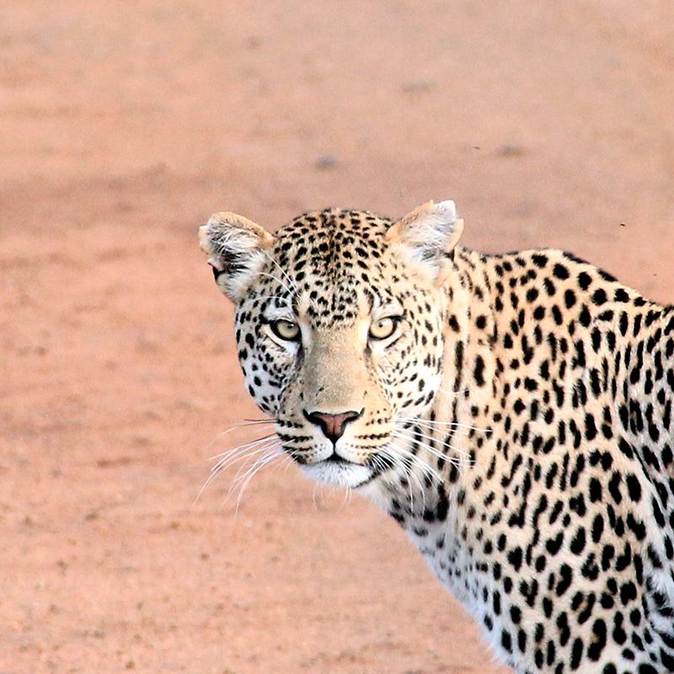
Hello!
I am Praneeth

Slide 3
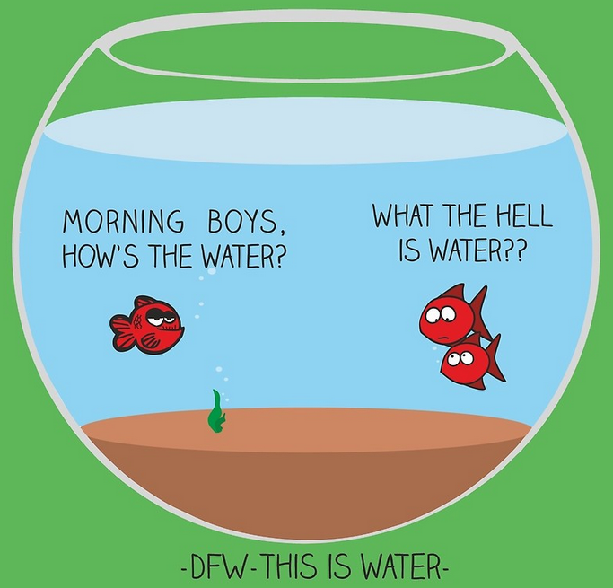
The immediate point of the fish story is that the most obvious, ubiquitous, important realities are often the ones that are the hardest to see and talk about.” — David Foster Wallace

Slide 4
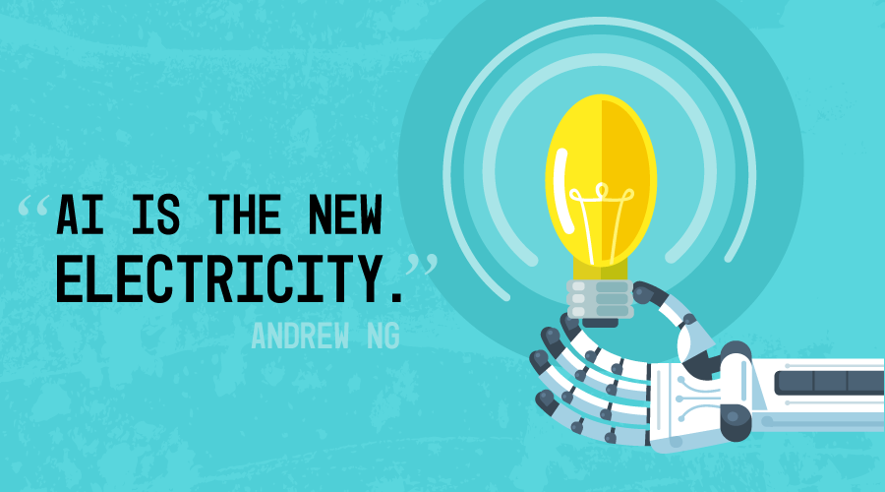

Slide 5
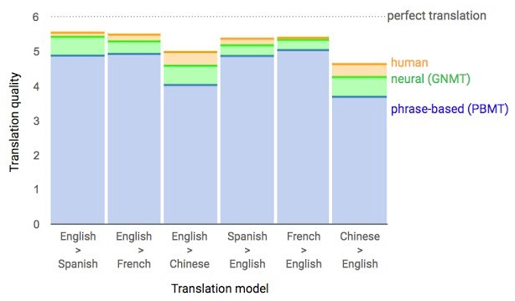
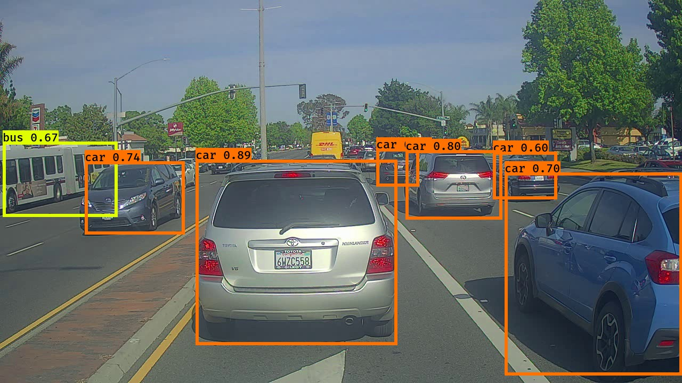
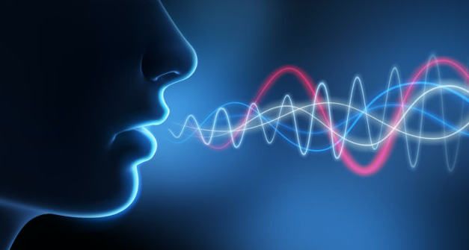
AI
Natural Language
Computer Vision
Speech & Audio

Slide 6
AI
9x
Published papers since 1998
11x
Course enrollment since 1996
14x
Startups since 2000
6

Slide 7
PROBLEM ?
It takes an average 12 years and exceeds $2.5 billion just to develop a single new drug, not to mention 90% of medicines in human studies fail.
It takes an average 12 years and exceeds $2.5 billion just to develop a single new drug, not to mention 90% of medicines in human studies fail.
Despite the huge growth of knowledge the process of scientific discovery HAS NOT CHANGED FOR 50 YEARS
Without technology’s help science based industries will REGRESS

Slide 8
PROBLEM ?
Drug discovery is still a guessing game. It takes an average 12 years and exceeds $2.5 billion just to develop a single new drug, not to mention 90% of medicines in human studies fail.
Notes:
Finding needle in a haystack
Despite the huge growth of knowledge the process of scientific discovery HAS NOT CHANGED FOR 50 YEARS

Slide 9
The real power of AI is here
13,847 diseases
5,000 treated
2,300 drugs
400 drug targets
Notes:
Why we still spinning our heads working on traditional drug discovery when we know that is not working.
Tremendous mismatch between amount of information available and our ability to cure diseases.

Slide 10
PROBLEM ?
Why we still spinning our heads working on traditional drug discovery when we know that is not working.
13,600 diseases
~5,000 known treatments
~8,000 unknown
Tremendous mismatch between amount of information available and our ability to cure diseases.
19,000 – 20,000 genes
400 targets

Slide 11
AI for Drug Discovery
Aggregate and Synthesize Information
Understand Mechanisms of Disease
Generate Data and Models
Repurpose Existing Drugs
Generate Novel Drug Candidates
Validate Drug Candidates
Design Drugs
Design Preclinical Experiments
Run Preclinical Experiments
Design Clinical Trials
Recruit for Clinical Trials
Optimize Clinical Trials
Publish Data

Slide 12

AI for Drug Discovery
Using Convolutional networks to discover and designing new small molecule drugs.
Improved hit rates by up to 10,000x and able to deliver accuracy comparable to wet lab experiments.
100 times faster than ultra high throughput screening.
Notes:
feature locality and hierarchical composition could be applied to the modeling of bioactivity and chemical interactions.
learns the features governing molecular binding
AtomNet, screens between 10 and 20 million compounds a day.

Slide 13

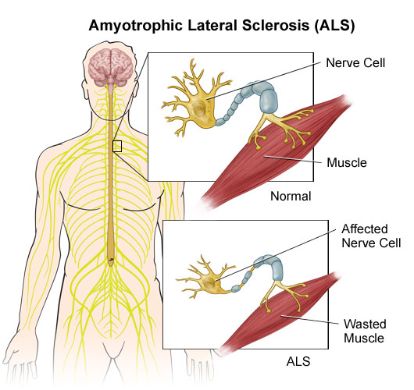
AI for Drug Discovery
Developed an AI platform that ingest scientific research data sets, then form and qualify hypotheses and generate novel insights.
5 Hypothesis in 5 hours to treat ALS disease.
Notes:
Tremendous mismatch between amount of information available and our ability to cure diseases.
A new scientific paper is published every 30 seconds, there are 10,000 updates to PubMed every day.
Their system can read natural languages, process data and generate new ideas
ALS – motor neuron disease.They identified a promising compound that prevents neuronal death

Slide 14

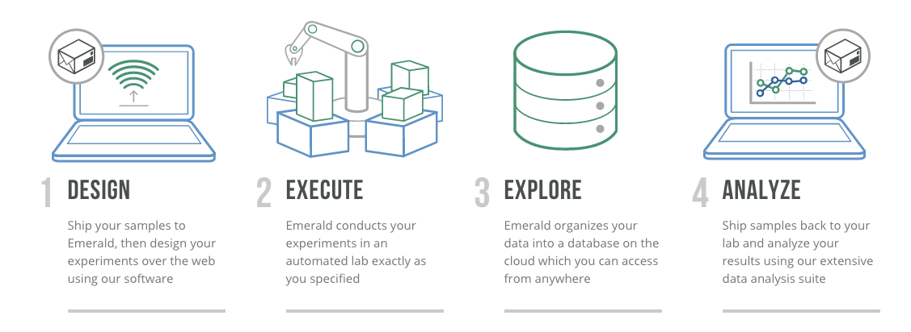
AI Startup
The ECL allow researchers / scientists experiments in a central lab from anywhere in the world.
Notes:
accelerate the rate of progress in pharmaceutical research, materials science, medical diagnostics
Problems : Linguistic ambiguity. Robots at the central lab has to understand the instructions.

Slide 15
















Slide 17
Big concept
Bring the attention of your audience over a key concept using icons or illustrations

Slide 18

Want big impact?
Use big image.

Slide 19
AI for Operations
Animal Behavior Analysis using Deeplearning

Slide 20
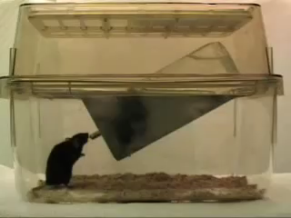
Place your screenshot here

Slide 21
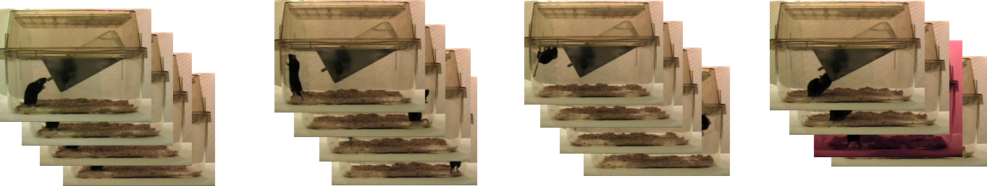
Place your screenshot here
Drink
Rear
Hang
Eat

Slide 22
Architecture

Slide 23
Thanks!
Any questions?
You can find me at:
@username
user@mail.me

Slide 24
Credits
Special thanks to all the people who made and released these awesome resources for free:
Presentation template by SlidesCarnival
Photographs by Unsplash & Death to the Stock Photo (license)

Slide 25
Presentation design
This presentations uses the following typographies and colors:
Titles: Roboto Slab
Body copy: Source Sans Pro
You can download the fonts on these pages:
https://www.fontsquirrel.com/fonts/roboto-slab
https://www.fontsquirrel.com/fonts/source-sans-pro
Blue #0091ea
Dark gray #263238
Medium gray #607d8b
Light gray #cfd8dc
You don’t need to keep this slide in your presentation. It’s only here to serve you as a design guide if you need to create new slides or download the fonts to edit the presentation in PowerPoint®

Slide 26
SlidesCarnival icons are editable shapes.
This means that you can:
Resize them without losing quality.
Change line color, width and style.
Isn’t that nice? :)
Examples:

Slide 27
😉
Now you can use any emoji as an icon!
And of course it resizes without losing quality and you can change the color.
How? Follow Google instructions https://twitter.com/googledocs/status/730087240156643328
✋👆👉👍👤👦👧👨👩👪💃🏃💑❤😂😉😋😒😭👶😸🐟🍒🍔💣📌📖🔨🎃🎈🎨🏈🏰🌏🔌🔑 and many more...

